Slide 1
CMSC 122 Scheduler
Chloe Pfeiffer, Chris Munoz, Jae Ahn, Angela Zhang
Notes:
Structure of presentation
Big Aim / goal
Graphic of what the outcome will look like
Proposed source of data
Image of uchcicago course website
Evaluations
Breakdown of functions
Libraries and programs we expect to use
Expected obstacles
Timeline + work assignments

Slide 2
Goal & Output
Tasks Breakdown
Expected Obstacles
Timeline & Work Assignments

Slide 3
Goal
The goal of our project is to provide advanced search and visualization functionality to the my.UChicago courses website. Our project will take a student’s existing (incomplete) class schedule and, based on criteria such as: the max number of hours a student wishes to spend on a class, a department, and meeting times/dates, return a list of classes that meet specifications and satisfy a base satisfaction score based on course evaluations. If a class recommended by our program is accepted by the student, our program will then output a calendar form of the student’s class schedule.
Notes:
Angela

Slide 4
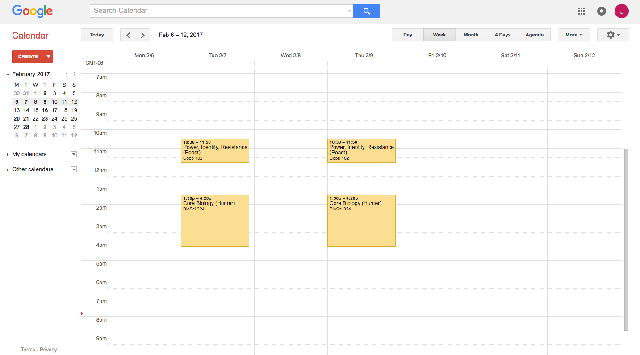
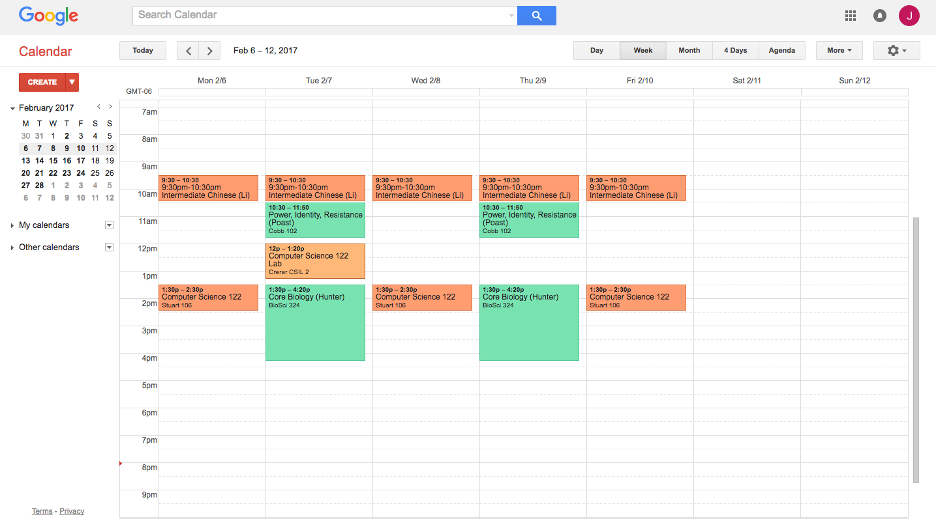
Output

Slide 5

Sources of Data
My UChicago Course Website
Course Name and Number
Class Dates and Times
Instructor(s)
Course Evaluations
High/Low/Average number of hours spent on class
Professor scores based on agree/disagree percentages
Course demands reasonable/unreasonable percentages
Potentially include most common words to describe course
Notes:
Angela

Slide 6




Task Breakdown
Webscrape for data
Scrape my.UChicago classes website
Scrape Course evaluations
Use RegEx and Selenium
Store data
Use SQL Database
Implement filters
Existing course inputs
Class logistics
Course evaluations
Provide user input
Utilize Django
Provide visual output
Sync with Google Calendar
Notes:
Jae

Slide 7

Expected Obstacles/Tools
Automate/handling of authentication (security issues)
Javascript loading
In tandem with beautifulsoup
Utilizing Selenium in order to bring up Javascript (HTML) elements in My.UChicago course website
Using webdriver to navigate clickable javascript elements
Messy HTML website

Slide 8
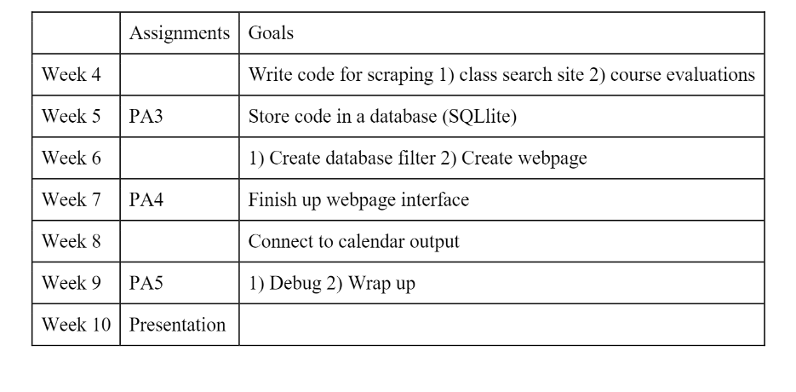
Timeline

Slide 9
Work Assignments
Chris: Using Selenium to scrape websites
Jae: Creating SQL database, storing data
Angela: Using Django to create website and user interface
Chloe: Connecting to Google API

